Slide 1
E2. Byzantine Generals Problem

Slide 2
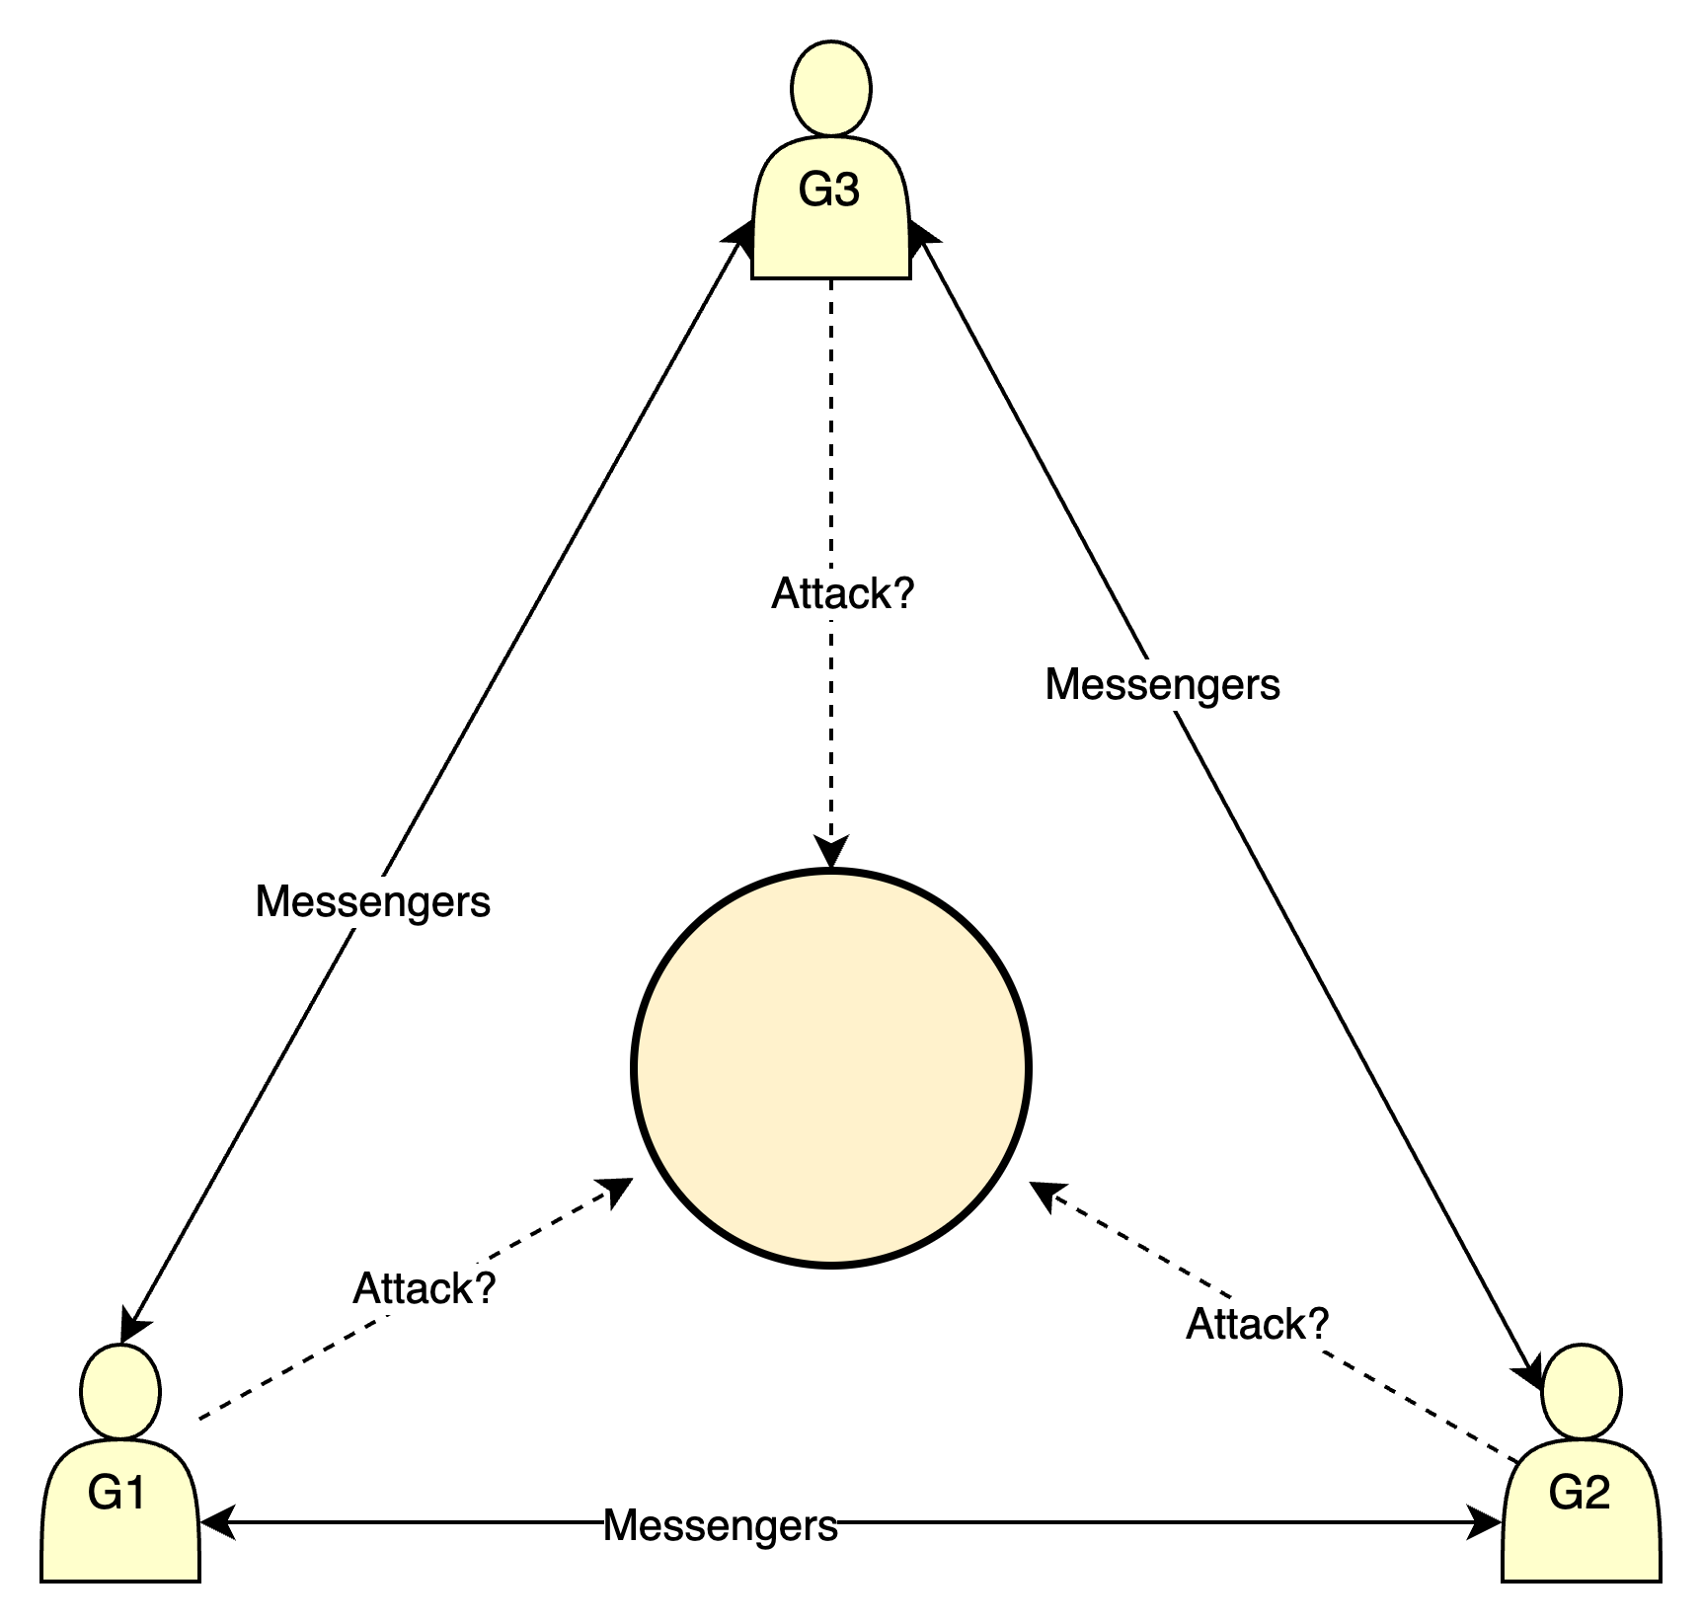
Byzantine Generals Problem
Generals exchange message on attack or retreat , but some of the generals may be traitors(not loyal, intentionally deceiving others).
What we want is being able for all loyal generals to come to an agreement, e.g. attack or retreat.

Slide 3
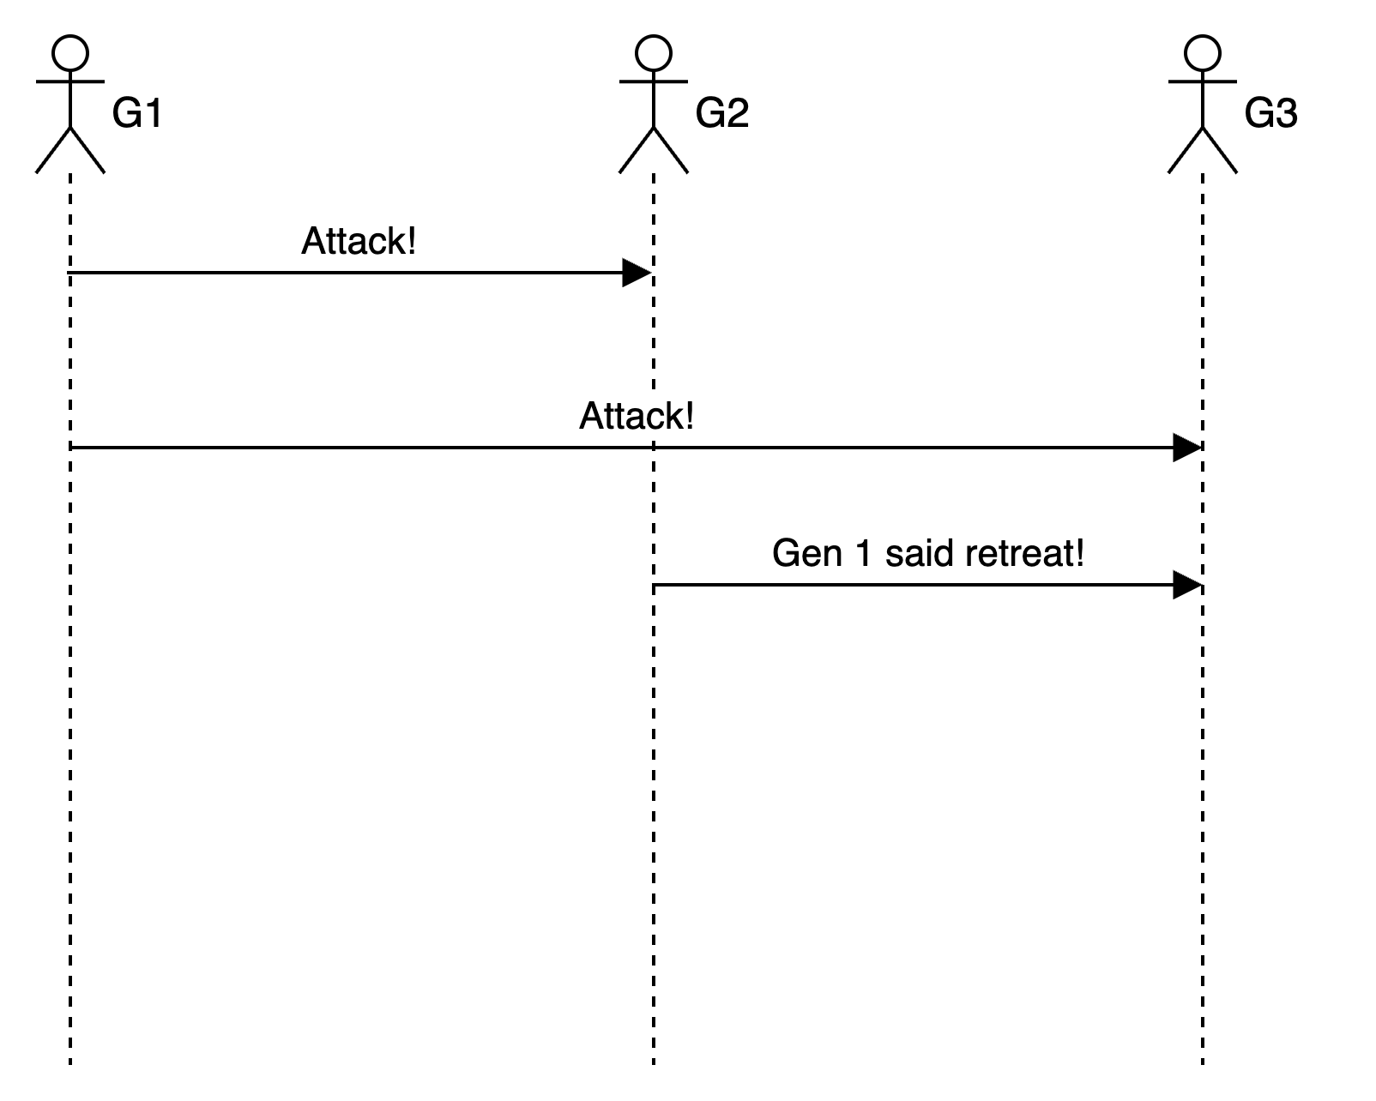
Scenario 1
G2 is not loyal and sends wrong message to G3.

Slide 4
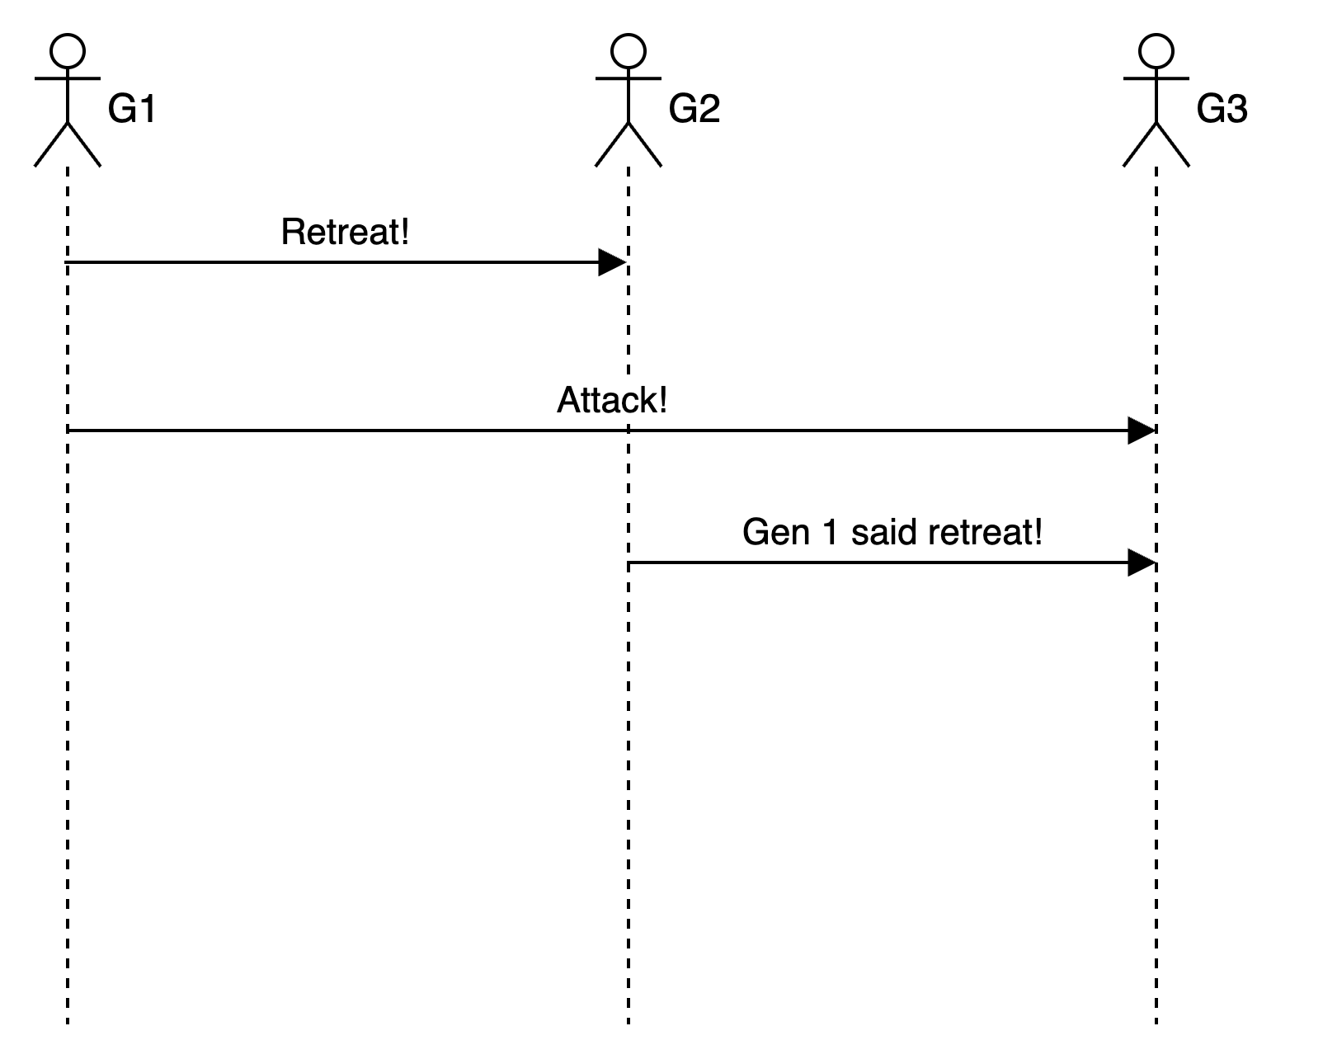
Three Generals with one traitor
From Gen. 3’s point of view these two scenarios are indistinguishable and it cannot know which of G1 and G2 is not loyal. So G3 cannot be sure which one of G1 or G2 is the traitor.
Consequently, with 3 generals and 1 traitor, it is impossible for B (and thus all loyal generals) to always reach a consistent agreement.
This is a proof that no algorithm can achieve consensus with 3 generals if even 1 is traitorous.

Slide 5
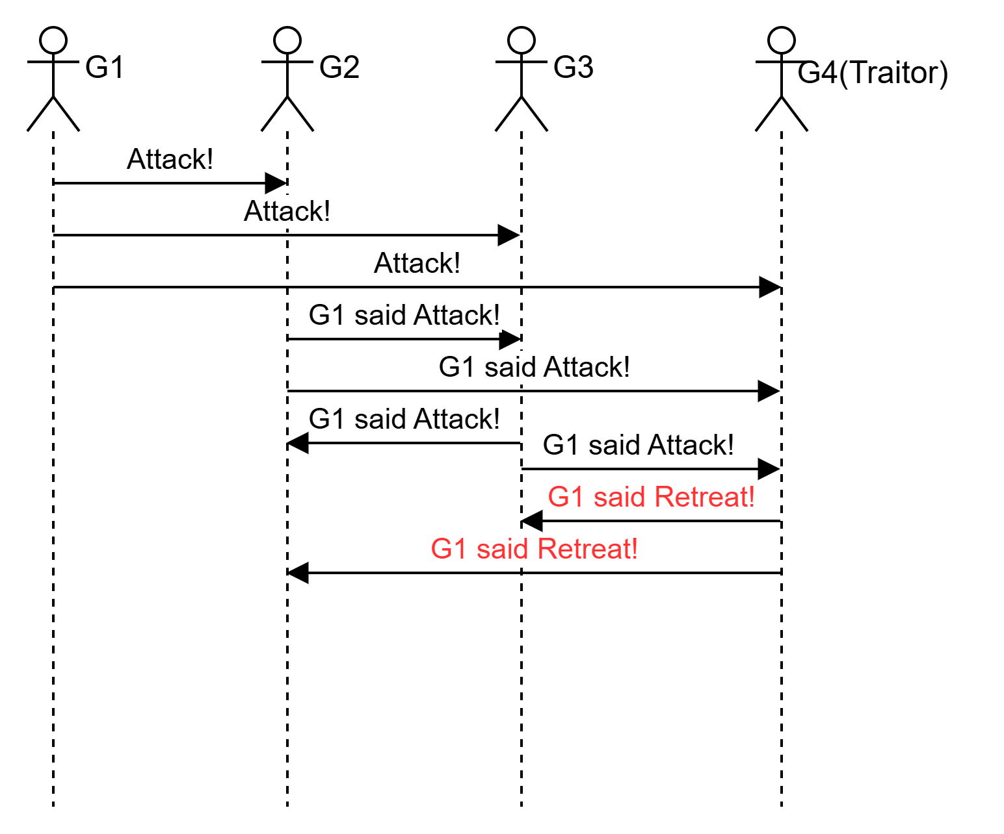
What if we add one more loyal general?

Slide 6
4 general with 1 traitor?
Each Lieutenant Collects Orders:
From | Received by G2 | Received by G3 | Received by G4
G1 (Commander) | ATTACK | ATTACK | ATTACK
G2 (Loyal) |  | G1 said ATTACK | G1 said ATTACK
G3 (Loyal) | G1 said ATTACK |  | ATTACK
G4 (Traitor) | G1 said RETREAT | G1 said RETREAT

Slide 7
Majority Vote
To achieve consensus, each general takes the majority decision from the messages they received:
G2 sees: "ATTACK", "ATTACK", "RETREAT" → Majority = "ATTACK".
G3 sees: "ATTACK", "ATTACK", "RETREAT" → Majority = "ATTACK".
Thus, all loyal generals decide on "ATTACK" despite the traitor’s attempt to deceive them.
Outcome
Consensus Achieved! Both loyal generals agree on the same decision ("ATTACK").
Traitor (G4) failed to disrupt the consensus because his single false message was outvoted.

Slide 8
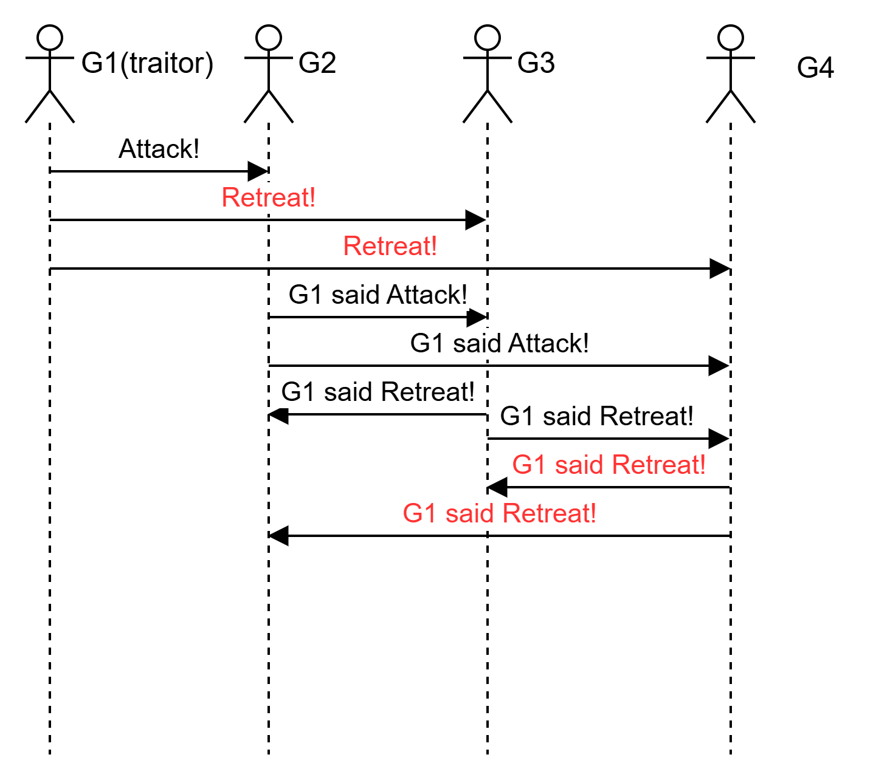
4/1 when the commander is the traitor

Slide 9
Each Lieutenant Collects Orders:
From | Received by G2 | Received by G3 | Received by G4
G1 (Commander Traitor) | ATTACK | RETREAT | RETREAT
G2 (Loyal) |  | G1 said ATTACK | G1 said ATTACK
G3 (Loyal) | G1 said RETREAT |  | G1 said RETREAT
G4 (Loyal) | G1 said RETREAT | G1 said RETREAT

Slide 10
The outcome is :
G2, G3 and G4 decide to RETREAT, coming to consensus.

Slide 11
Byzantine Generals Problem
Up to f(of n) generals might behave maliciously.
Honest generals don’t know who the malicious generals are.
The malicious generals may behave in a coordinated fashion.
Nevertheless, the honest generals must agree on a plan.
How can the loyal generals reach a unanimous agreement on the plan of action, despite the presence of traitors sending conflicting information?

Slide 12
Key aspects of the Byzantine Generals Problem
Communication: Generals can only communicate by sending messages (thru messengers). There is no shared memory or broadcast channel aside from these messages. In the classical form, messages are oral (not cryptographically signed), meaning a traitor can forge or alter messages arbitrarily.
Consensus Goal: All loyal (non-faulty) generals must agree on the same decision (attack or retreat), and if the designated commanding general is loyal, then that agreed-upon decision must be the exact order he proposed. In other words, the system should satisfy:
Agreement: All loyal generals decide on the same course of action.
Validity: If the commanding general is loyal, then all loyal generals adopt the commander’s order as the final decision.
These two properties (sometimes called interactive consistency conditions IC1 and IC2) capture the essence of Byzantine agreement​. The challenge is that traitors may send inconsistent messages to different parts of the network, attempting to confuse the loyal generals.

Slide 13
The theorem
Theorem: n > 3f generals are enough to tolerate f malicious generals.
Cryptography(digital signatures) helps, but problem remains hard.

Slide 14
Explanation
If n ≤ 3f, the Byzantine Generals Problem is unsolvable (you cannot guarantee that all loyal processes agree),
If n ≥ 3f+1, there is a protocol that solves the Byzantine Generals Problem for up to f Byzantine faults.
*L. Lamport, R. E. Shostak, and M. C. Pease. 1982. The Byzantine generals problem. ACM Trans. Program. Lang. Syst., 4(3): 382–401.

Slide 15
More formal statement of the problem
We have n total processes (generals), of which up to f might be Byzantine (meaning they can behave arbitrarily or maliciously). Among these n processes:
There is one distinguished Commander (also called the "General" in the original formulation).
The other n−1 are called Lieutenants.
A protocol must allow every loyal lieutenant to decide on a value. We require:
Agreement: All loyal lieutenants decide on the same value.
Validity: If the commander is loyal and proposes value v, then every loyal lieutenant must decide v.
In other words, we want to ensure that no matter what the f faulty processes do, the loyal processes come to one common decision (agreement), and if the commander is not faulty, that decision is exactly what the commander proposed (validity).

Slide 16
Statement of the theorem
Theorem (Lamport–Shostak–Pease)
Necessity: If n≤3f, then no protocol can guarantee agreement.
Sufficiency: If n≥3f+1, then there exists a protocol (OM(f), a recursive “oral messages” algorithm) that guarantees agreement.

Slide 17
Proof: Necessity. The High-Level Idea
If n≤3f, the adversary(traitor generals) can partition the loyal processes and inject inconsistent information so that different loyal subsets end up making different decisions. Concretely:
The faulty processes (≤f) can “stand between” or confuse messages between two subsets of loyal processes.
Each subset of loyal generals(processes) sees a different “picture” of the system, making it impossible to agree on a single value.

Slide 18
Sketch of Proof(Necessity)
Number of Loyal vs. Faulty
Since n ≤ 3f, the maximum number of loyal processes is n−f ≤ 2f.
Thus, all loyal processes can be split into two disjoint groups each of size at most f. Denote them Gr1​ and Gr2​.
Construct Two Scenarios
Scenario A: The commander (assume it is loyal) is in Gr1​, proposes a value vA​
Scenario B: The same commander (also loyal) is in Gr2, proposes a different value vB.
Traitors as “Bridges”
There are up to f traitors, place them so that they control communication between Gr1 and Gr2.
In Scenario A, the adversary can deliver correct messages within Gr1 but can corrupt all messages to/from Gr2​
In Scenario B, the adversary does the same but reversed roles for Gr1​ and Gr2.
Indistinguishability
From Gr1​’s viewpoint, it sees a loyal commander in Scenario A sending vA​. In Scenario B, the traitors can fake the same or different messages, making the situation look identical or ambiguous to Gr1​. Similarly for Gr2.
The sets Gr1 and Gr2​ cannot reliably distinguish which scenario they are in, due to the traitors controlling cross-group messages.​
Contradiction
In Scenario A, all loyal processes in Gr1 must decide vA​, and in Scenario B, all loyal processes in Gr2​ must decide vB​.
But the processes in Gr1​ (respectively Gr2​) have no way to differentiate these scenarios, so they cannot be guaranteed to produce a single consistent outcome.
Hence, there is no protocol that can ensure both agreement and validity if n ≤ 3f.
This shows the necessity of having at least n > 3f.

Slide 19
Proof: Sufficiency, OM(f) protocol
Why n ≥ 3f+1 is sufficient?
A recursive algorithm OM(f):
A single commander is sending a value to its n−1 lieutenants.
Base Case: OM(0).
If f = 0, the commander just sends its value v to all lieutenants, and they accept v. Agreement is trivial and correct.
General Case: OM(f) for f ≥ 1.
Step 1: The Commander Sends the Value. The (possibly faulty) commander sends a value to each lieutenant. If a lieutenant receives no message or a malformed message, it uses some default (e.g., ⊥).
Step 2: Each Lieutenant Becomes a Sub-Commander. Each lieutenant i who received value vi​ from the commander now runs OM(f−1) as the commander with the other n−2 processes (excluding the original commander and itself). In other words, lieutenant i sends vi​ to these other processes, who then recursively execute OM(f−1).
Step 3: Decision via Majority. After these sub-rounds finish, each lieutenant collects the decisions from the OM(f−1) runs initiated by each of the other lieutenants.
If these decisions are all the same value v∗, the lieutenant decides v∗ .
If there’s any disagreement among them, the lieutenant uses a majority (or a consistent-subset) rule to “filter out” contradictory messages.
This protocol ensures that, whenever n ≥ 3f+1, a minority of up to f faulty processes cannot prevent the loyal lieutenants from converging on one value.

Slide 20
Correctness of OM(f). Proof by Induction.
Inductive Claim: OM(f) satisfies:
If the commander is loyal, all loyal lieutenants decide on the commander’s actual value.
If the commander is faulty, all loyal lieutenants decide on the same value (not necessarily the commander’s true value).
Proof:
Base Case: f=0
No faulty processes exist, so the commander sends its value v to all lieutenants, and they decide v. Agreement and validity hold trivially.
Inductive Step
Assume for some k ≥ 0, OM(k) works correctly if n>3k. We must show that OM(k+1) works when n > 3(k+1).

Slide 21
Correctness of OM(f). Proof by Induction.
Case A: Commander is Loyal
The loyal commander sends out a single value v.
Each loyal lieutenant i receives v. (A faulty lieutenant might receive something else, but that does not affect loyal lieutenants’ decisions.)
Lieutenant i runs OM(k) as a sub-commander with value v.
If i is loyal, then by the induction hypothesis (and because it deals with at most k faults in its subproblem), all loyal participants in that subproblem get v.
When each loyal lieutenant collects the results from these OM(k) subproblems, a strict majority will report v (since the number of loyal sub-commanders is at least n−1, and n−1 > 3k). Thus, each loyal lieutenant decides v.

Slide 22
Correctness of OM(f). Proof by Induction.
Case B: Commander is Faulty
The faulty commander can send different values to different lieutenants.
Each lieutenant i (loyal or faulty) becomes sub-commander in OM(k).
If lieutenant i is loyal and received vi, it sends exactly vi to all processes in the subproblem. By induction, all loyal participants in that subproblem agree on vi​.
If lieutenant i is faulty, it might send conflicting values, but still, by induction, all loyal participants in that subproblem come to some single decision di​. (We do not care exactly which value, only that they all match within that subproblem.)
Hence, each original lieutenant ends up with a collection {d1,d2,…,dn−1}. The final step in OM(k+1) is to take a consistent majority out of these decisions. Because at most k lieutenants can be faulty, all loyal lieutenants apply the same filtering rule and converge on one common value.

Slide 23
Conclusion
Necessity (n ≤ 3fn): By a partitioning argument, traitors can confuse two disjoint sets of loyal processes, forcing them into different decisions. No protocol can guarantee agreement.
Sufficiency (n ≥3 f+1): The recursive OM(f) protocol uses majority filtering at each level. Because n > 3f the loyal majority “overwhelms” traitor attempts to lie. An inductive argument shows that all loyal generals agree on the same value; if the commander was loyal, they get the actual commander’s value.
Hence the classical result:
Byzantine Agreement is solvable exactly when n ≥ 3f+1.​
This is the cornerstone theorem for synchronous Byzantine fault tolerance with “oral messages” (no signatures). It shows that to tolerate f arbitrary (Byzantine) faults, one must have at least 3f+1 total processes.

Slide 24
Real Word Examples
Distributed Databases & Microservices
Why It’s a BGP Issue
Large-scale systems often replicate data across many servers for fault tolerance and performance.
A compromised node or network glitch could cause arbitrary (Byzantine) data corruption, stale reads, or conflicting transaction logs.
How It’s Solved
Practical Byzantine Fault Tolerance (PBFT with keys): Some distributed databases or key-value stores use PBFT-like protocols where a majority of correct replicas can override any faulty ones.
Secure Raft / Paxos Variants: While classic Paxos/Raft assume crash faults, specialized variants add cryptographic checks and additional voting steps to handle Byzantine faults.
Result: Despite some nodes being out of sync or malicious, the overall system maintains one correct, consistent state for all honest clients.

Slide 25
Real Word Examples
2. Payment Networks & Financial Systems
Why It’s a BGP Issue
Global payment networks (e.g., SWIFT, inter-bank settlement) involve multiple institutions.
A compromised or rogue bank node could send false transaction confirmations or try to fork the record of who paid whom.
How It’s Solved
Audited Byzantine Consensus: Some private ledgers or blockchain-based settlement solutions use BFT consensus among banks, so a majority of participants must confirm a transaction.
Secure Messaging Protocols: Even if a node attempts to send conflicting instructions, other participants rely on cross-confirmations and majority agreement before finalizing transactions.
Result: The network consistently finalizes and logs valid transactions despite potential insider attacks or node failures

Slide 26
Real Word Examples
3. Public Blockchains (e.g., Bitcoin, Ethereum)
Why It’s a BGP Issue
In a decentralized blockchain, many nodes must agree on the next block in the chain.
Some nodes may be faulty (due to crashes, network splits) or malicious (attempting double-spends, rewriting history).
How It’s Solved
Proof of Work (PoW): Each node expends computational effort to propose a block. Honest nodes follow the chain with the most cumulative work. This design tolerates a portion of malicious hash power yet can still converge on a single chain.
Proof of Stake (PoS) and BFT Protocols (e.g., Tendermint, HotStuff): Nodes stake cryptocurrency and run a Byzantine Fault Tolerant consensus that finalizes blocks, preventing malicious nodes from creating conflicting ledger histories.
Result: Despite some fraction of participating nodes potentially being malicious, the network converges on one shared ledger of transactions.

